Slide 1
SMARCLE
2023
MAKERS
DAY
Legend NINE
WEEK 3
이계무, 오승민, 박찬얼, 박경준

Slide 2
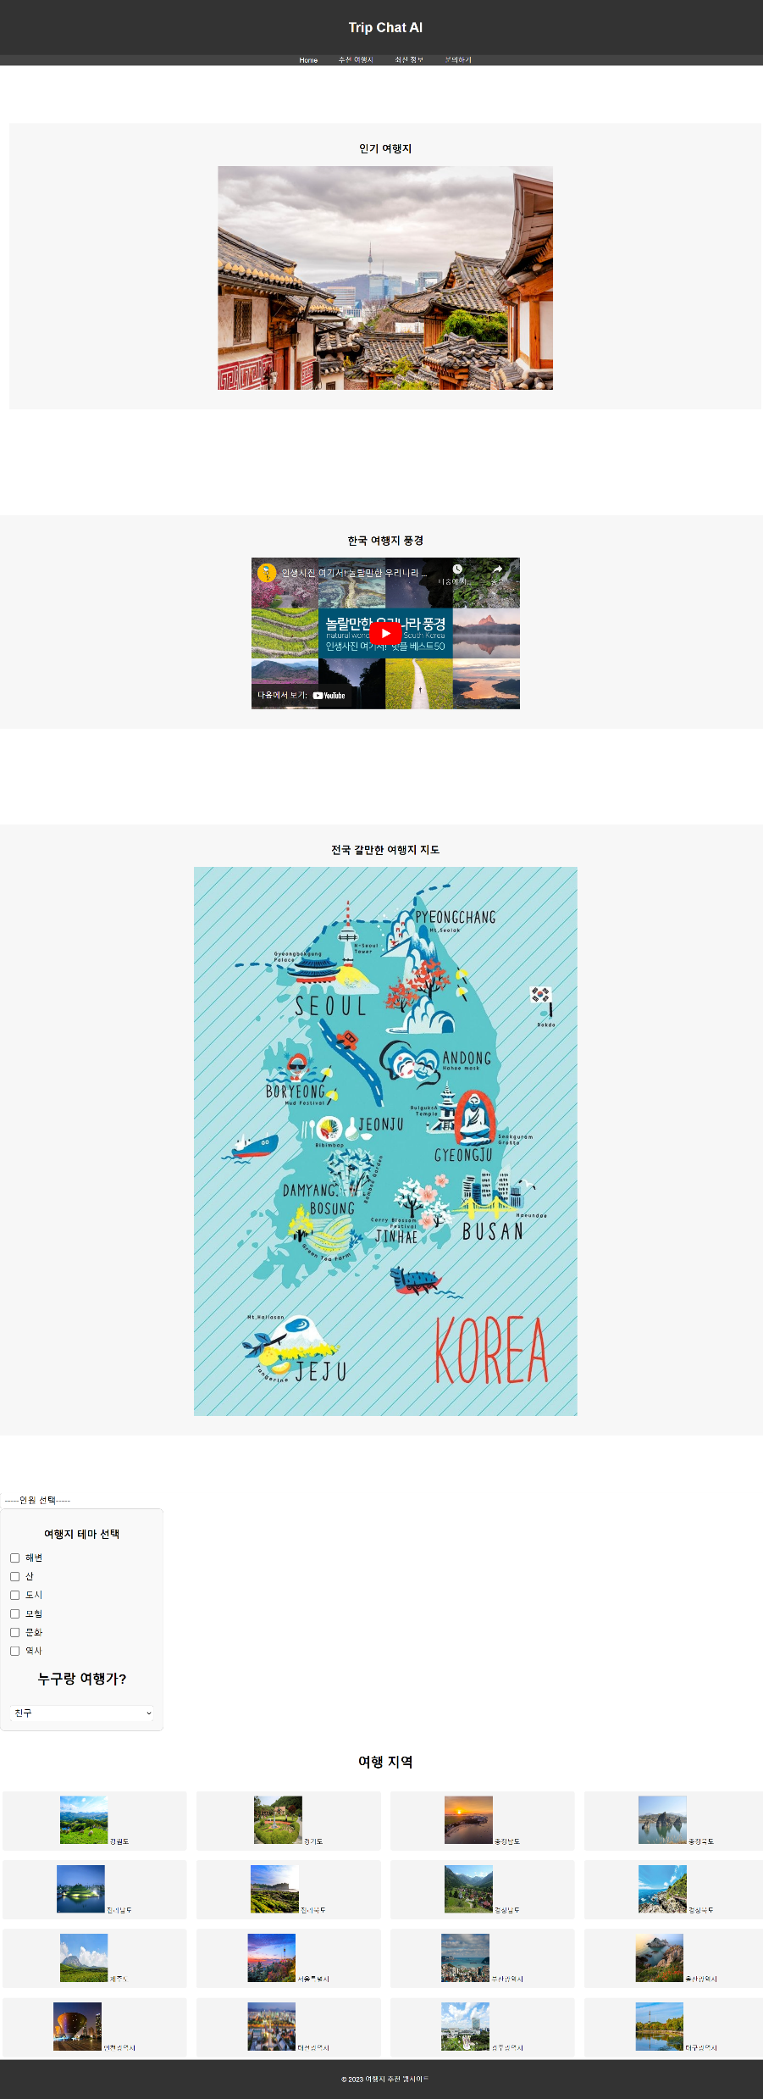
WEEK 3
샤라웃 오승민

Slide 3

WEEK 3

Slide 4
WEEK 3

Slide 5
WEEK 3

Slide 6
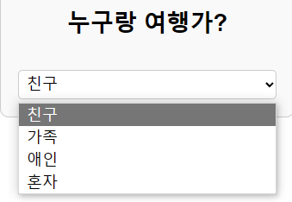
WEEK 3

Slide 7
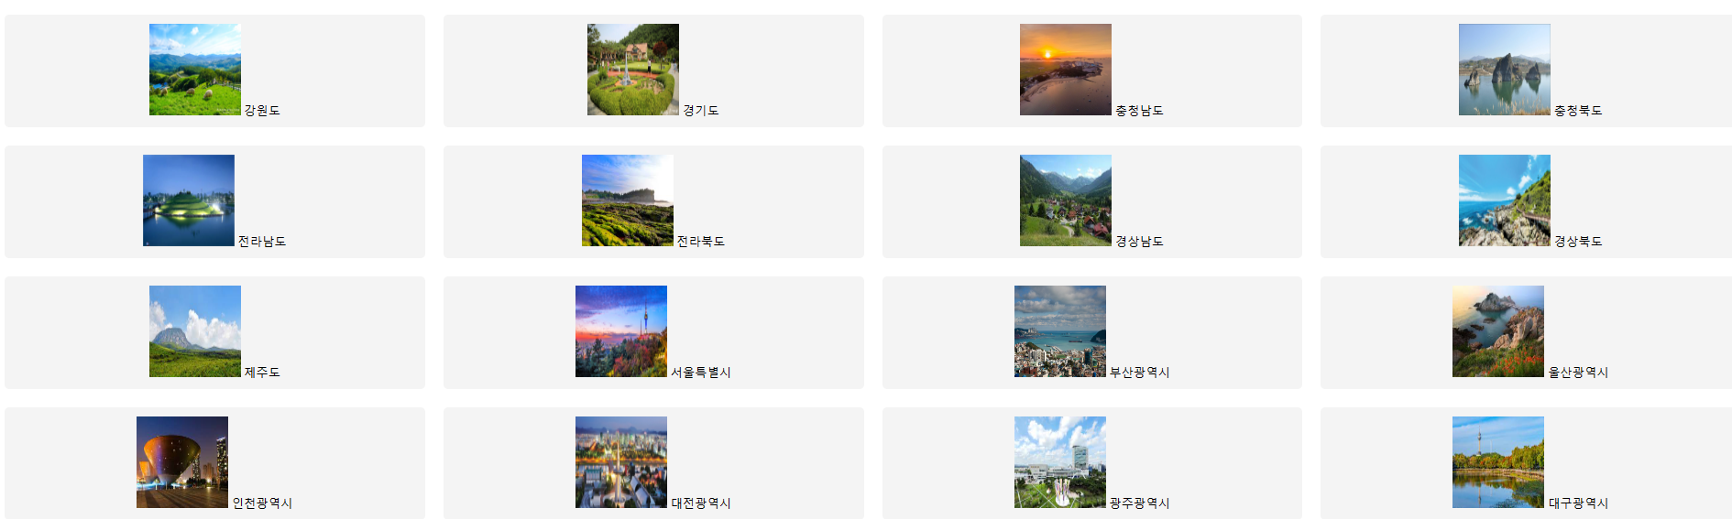
WEEK 3

Slide 8
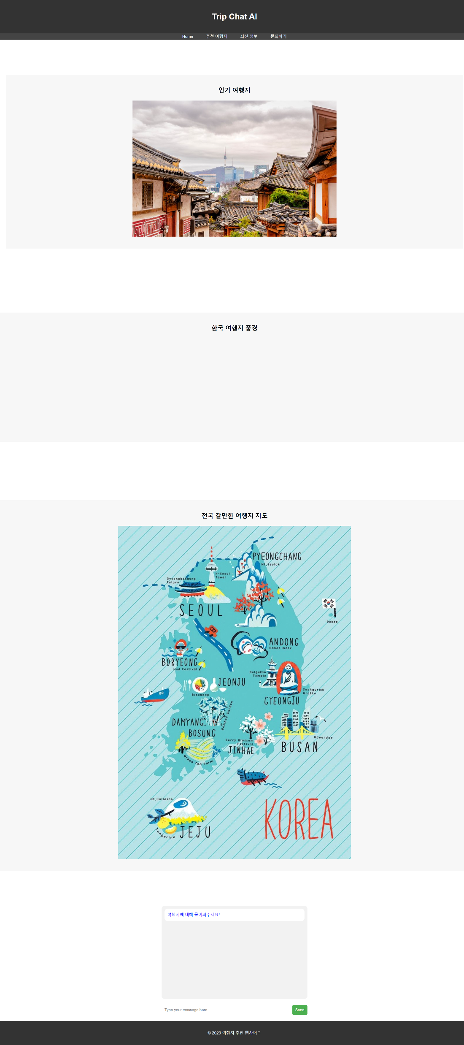
WEEK 3

Slide 9
WEEK 4

Slide 10
WEEK 4

Slide 11
WEEK 4

Slide 12

WEEK 4

Slide 13
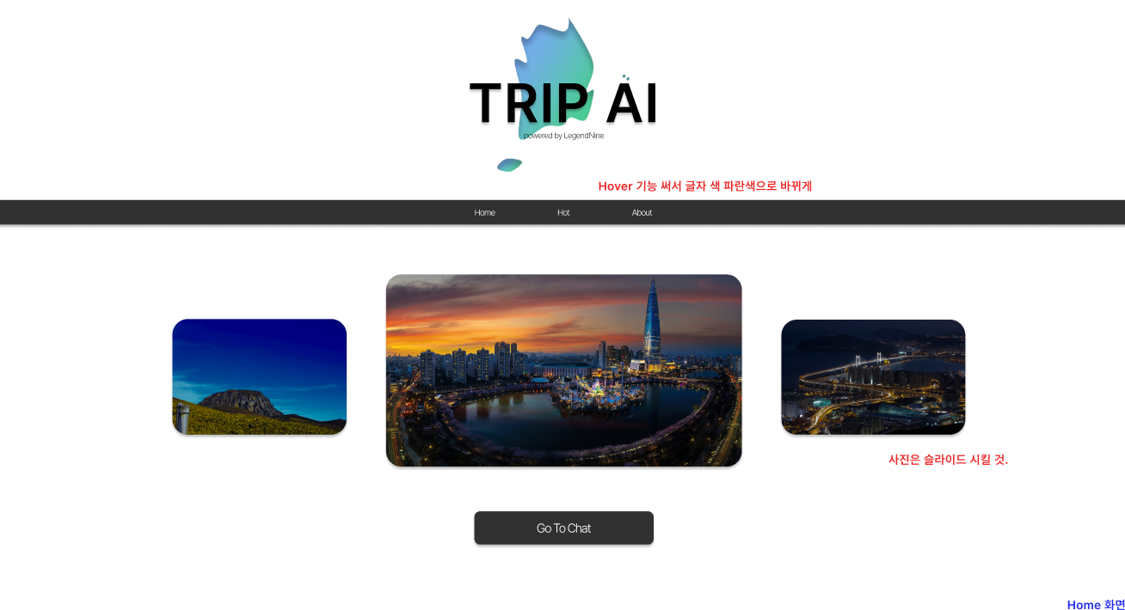
WEEK 4
샤라웃 박경준

Slide 14
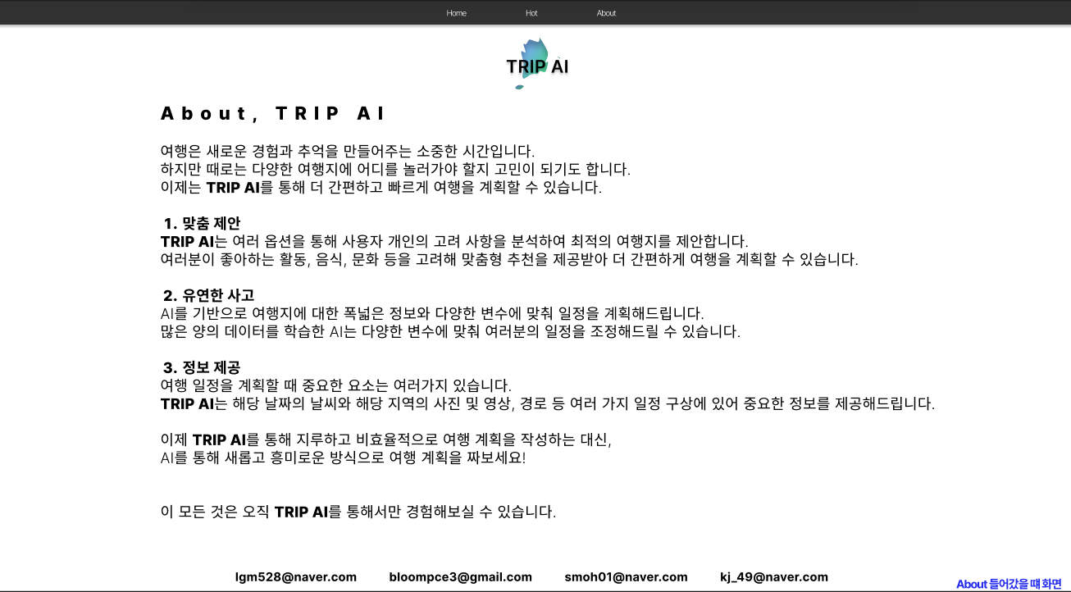
WEEK 4

Slide 15
WEEK 4

Slide 16
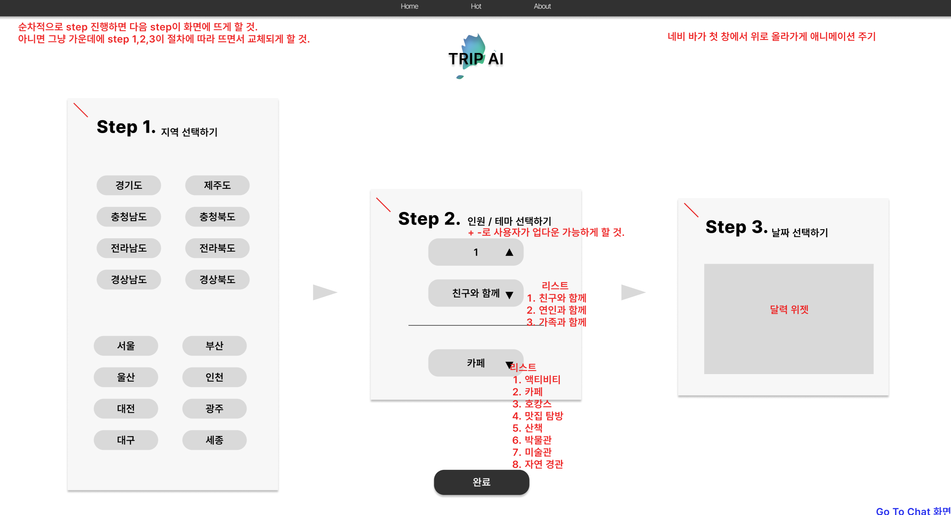
WEEK 4

Slide 17
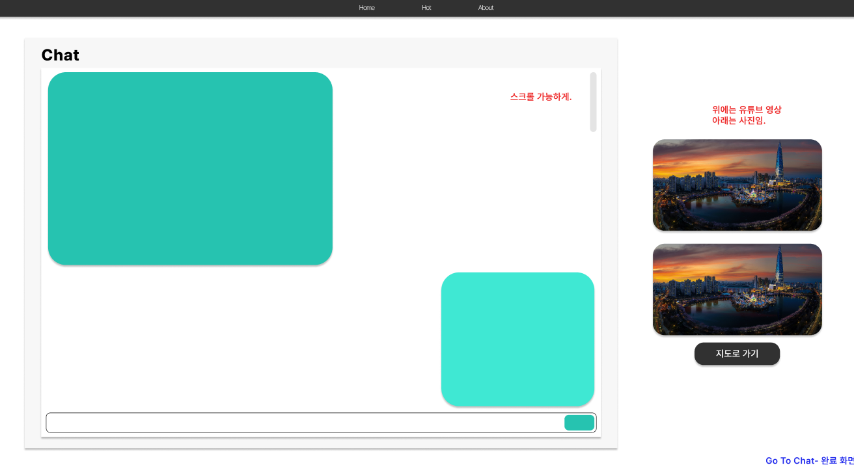
WEEK 4

Slide 18
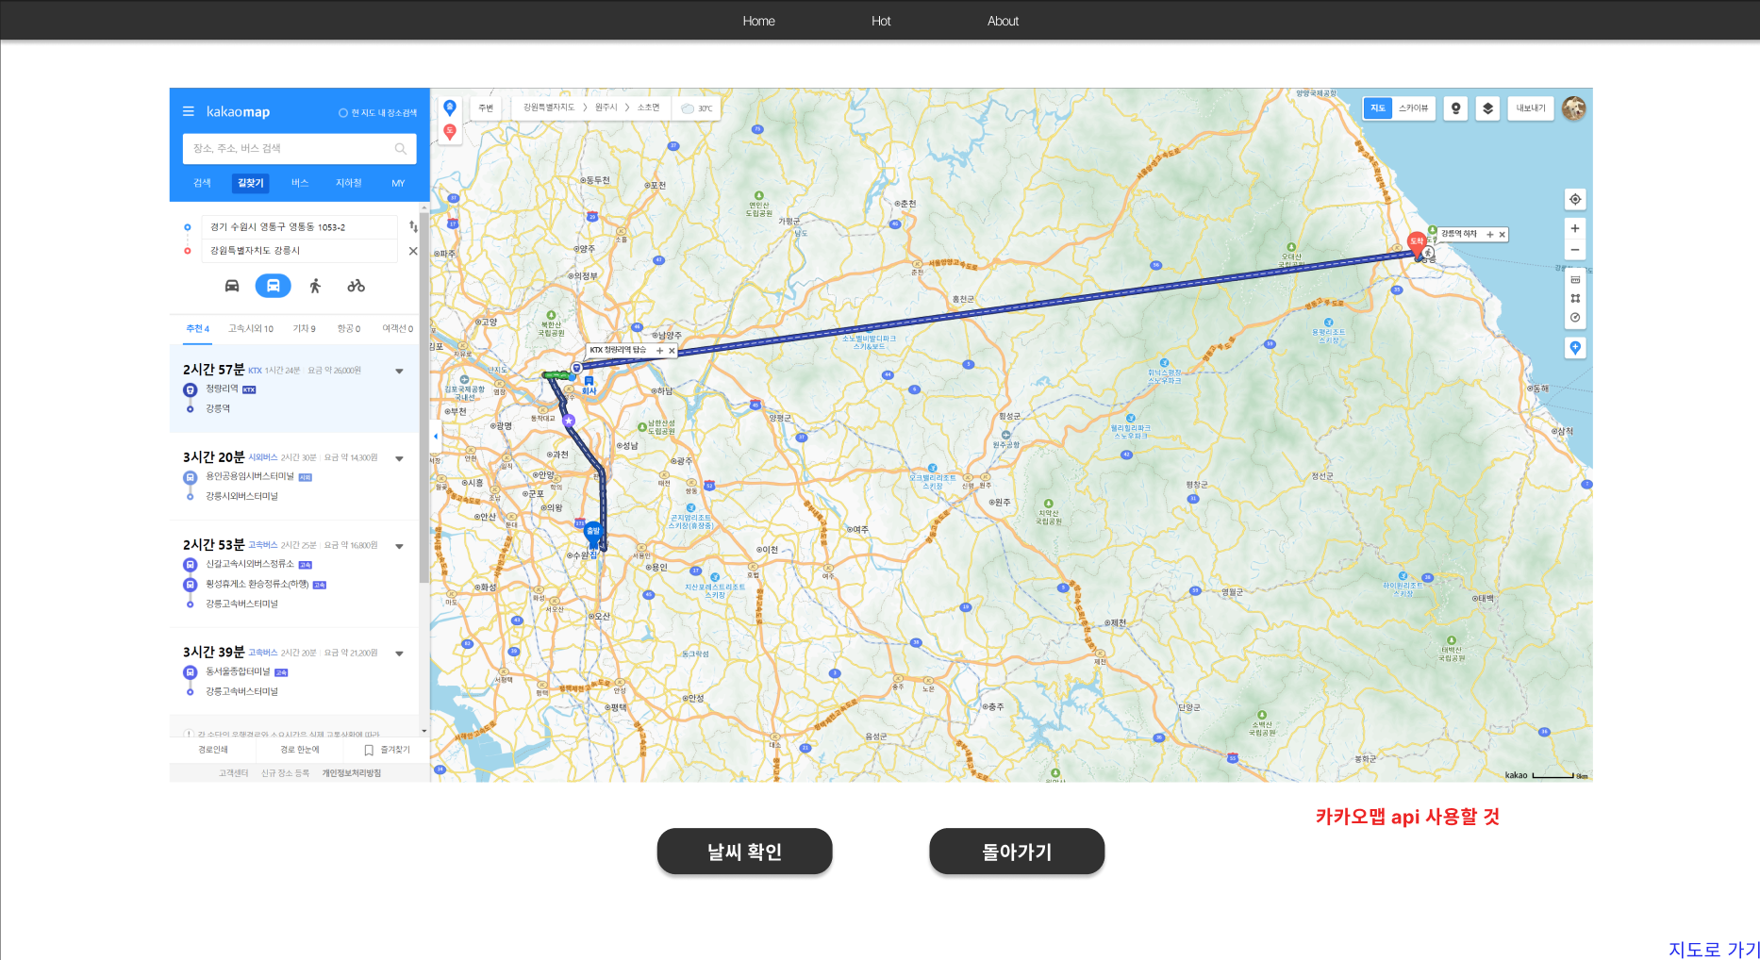
WEEK 4

Slide 19
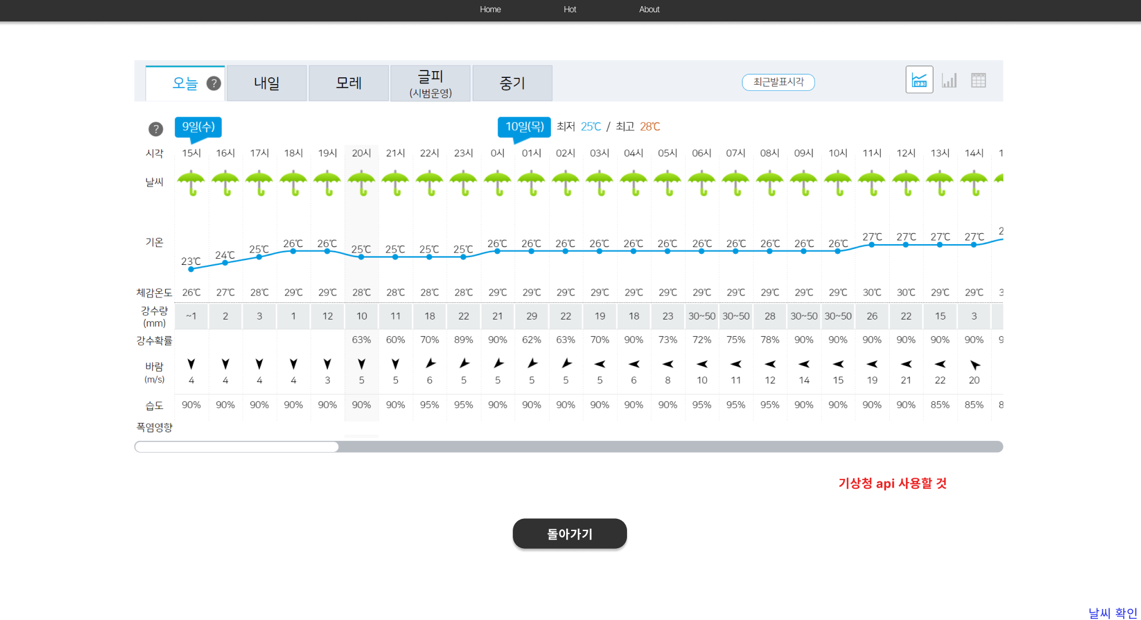
WEEK 4

Slide 20
WEEK 5
Map Api
Weather
Design to css
New Feature
Study

